Slide 1
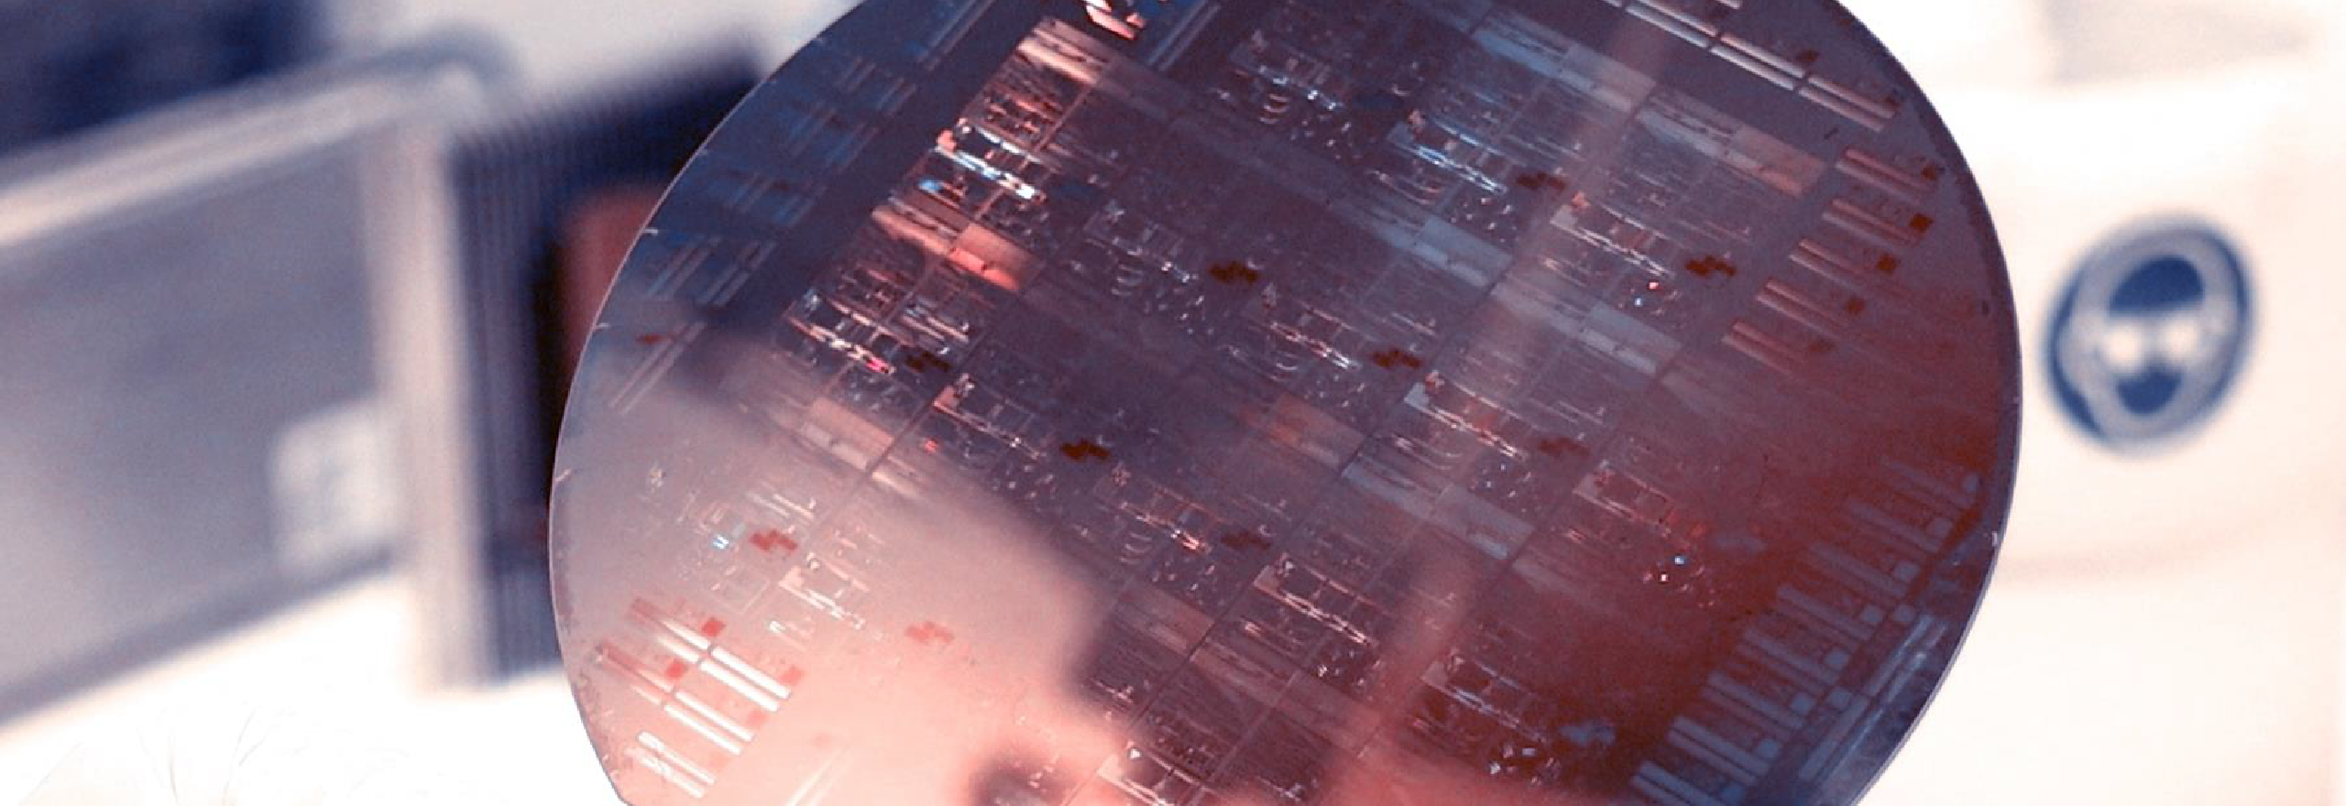
Lab Book 1.0. Waveguides
Student:

Slide 2
Instructions General
SOFTWARE
Python notebook supplied by instructors
SCRIPTS
From Poliformat → download the 10_WAVEGUIDES_v2025_Student.ipynb
Either run locally or at Google Collaboratory
W (width)
W (width)
Core
Core
h_core
h
(height)
Cladding
Cladding
Slab
h_slab
deep waveguide
shallow waveguide

Slide 3
Learning outcome #1 – Convergence tests SH & DE waveguide, w = 1.2 µm, neff_TE0, wvl 1.55 µm. Change grid_resolution from 6 to 150 (Set your own spacing between points).
deep waveguide
Paste neff_TE0 vs grid_resolution plot here
shallow waveguide
Paste neff_TE0 vs grid_resolution plot here
slab = 150nm
Comment results, determine above which grid value the effective index calculation does not change significantly

Slide 4
Learning outcome #2 – Mode confinement with wavelength deep waveguide (w=0.8 µm) - wavelengths from 1.5 µm to 1.8 µm. Use the .mode_area() parameter of the gt.modes.Waveguide() function for this analysis.
deep waveguide
Paste modal plots at 1.5 µm and 1.8 µm
deep waveguide
Paste Mode area vs wavelength plot here
Comment results, not only graphic ones, but also the associated effective index with respect to the core and cladding material indices

Slide 5
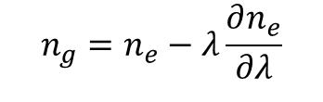
Learning outcome #3 – Group index calculation LO#2 Lab 0.1. Wavelength 1.5-1.6 µm (step 0.02 µm), width 0.8-1.2 µm (0.1 µm step). Calculate ng
deep waveguide
Paste ng vs wavelength plot here
shallow waveguide
Paste ng vs wavelength plot here
slab = 150nm
Comment results, group index variation over wvl (if any) then comparison of values between shallow and deep waveguide
$$n_{g}=n_{e}−λ\frac{∂n_{e}}{∂λ}$$

Slide 6
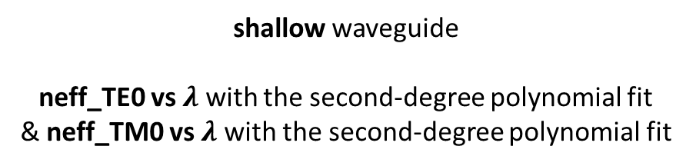

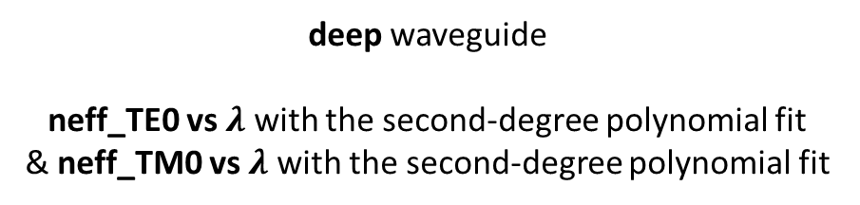

Learning outcome #4 – Waveguide compact model Let’s model the waveguide using a second order polynomial: $$n_{eff}\left(λ\right)=n_{1}+n_{2}\left(λ−λ_{0}\right)+n_{3}{\left(λ−λ_{0}\right)}^{2}$$
deep waveguide
neff_TE0 vs $λ$ with the second-degree polynomial fit
& neff_TM0 vs $λ$ with the second-degree polynomial fit
shallow waveguide
neff_TE0 vs $λ$ with the second-degree polynomial fit
& neff_TM0 vs $λ$ with the second-degree polynomial fit
slab: 150nm
Find the second-degree polynomial coefficients and relate them with the group index and the dispersion parameter. $\left\{\begin{aligned}n_{eff}=n_{1} \\ n_{g}=n_{1}−n_{2}λ_{0} \\ D=−\frac{2λ_{0}n_{3}}{c}\left[\frac{s^{2}}{m}\right]\end{aligned}\right.$
Comment on the results found for the TE0 and TM0 for both deep and shallow waveguides.

Slide 7

Learning outcome #5 – Bend waveguide radius vs. loss – deep Find neff_TE0 & neff_TM0 for wvl 1.55 µm, width 1.0 µm for R=25,50,75,100, 125,150 µm
deep waveguide
Paste dB/90º neff_TE0 & neff_TM0 vs R
$α\left[\frac{dB}{90°}\right]=$ $R\frac{π}{2}α\left[\frac{dB}{µm}\right]$
Comment results, which is the safe radius, consider safe means less than 0.1 dB/90º.

Slide 8

Thank you

